Slide 1
Soundscapy
A Python Package for Soundscape Assessment and Analysis Andrew Mitchell

Slide 2
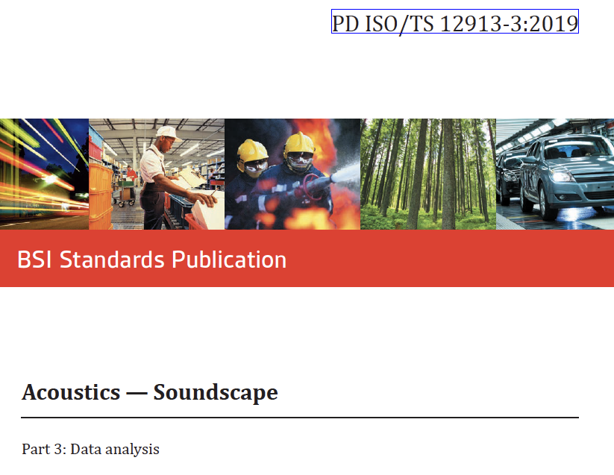
Introduction
Soundscape: A holistic approach to understanding and assessing acoustic environments
ISO 12913 series provides a standardized framework for soundscape data collection and analysis (introduced in 2018)
Despite standardization, challenges persist in consistent application and interpretation
Soundscapy addresses these challenges through:
An open-source Python package accessible to researchers and practitioners
Alignment with ISO 12913-3 guidelines for consistency (including upcoming revisions)
Facilitating reproducible and standardized analysis workflows
Bridging the gap between theoretical soundscape concepts and practical applications
Enabling large-scale soundscape studies with efficient data processing
ISO 12913-3 recommendations for soundscape analysis
Notes:
Introduce the concept of soundscape as a holistic approach to acoustic environments
Highlight the importance of the ISO 12913 series in standardizing soundscape assessment
Emphasize the ongoing challenges in applying these standards consistently across studies
Present Soundscapy as a comprehensive solution to these challenges
Mention its strict alignment with ISO guidelines and focus on reproducibility and standardization
Highlight how Soundscapy bridges the gap between theory and practice in soundscape research

Slide 3

Soundscapy: Origins and Purpose
Developed as part of the Soundscape Indices (SSID) project, an ERC Horizon 2020 Grant
Built upon the SSID Protocol, a standardized method for in situ soundscape data collection
Builds upon the extensive International Soundscape Database (ISD) and other ISO 12913-2 datasets
Key features and innovations:
Advanced visualization using distributional methods for nuanced soundscape representation
Comprehensive psychoacoustic and acoustic analysis capabilities for binaural recordings
Optimized for efficient processing of large-scale soundscape datasets
Ensures consistency with ISO 12913-3 guidelines throughout the analysis pipeline
Notes:
Explain Soundscapy’s origins within the context of the SSID project, a significant research initiative
Highlight its foundation on the SSID Protocol, emphasizing standardized data collection methods
Discuss the integration with the International Soundscape Database (ISD) and its importance
Emphasize key features: advanced visualization, comprehensive analysis capabilities, and scalability
Demonstrate the simplicity of installation and basic usage with code examples
Reinforce Soundscapy’s adherence to ISO standards, ensuring consistency in soundscape research
Highlight how Soundscapy makes advanced soundscape analysis techniques accessible to a wider audience

Slide 4
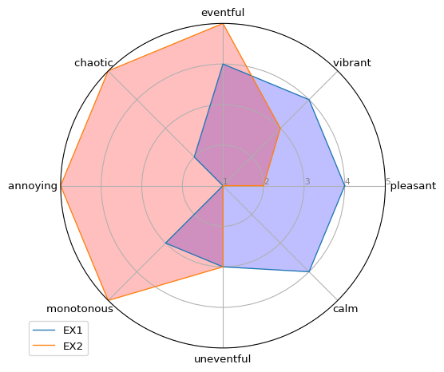
Soundscape Circumplex Model
Proposed by Axelsson, Nilsson, and Berglund (2010)
Comprises two orthogonal dimensions that capture key aspects of soundscape perception:
Pleasant-Annoying (x-axis)
Eventful-Uneventful (y-axis)
Eight perceptual scales
Officially adopted in ISO/TS 12913-2, quickly becoming the dominant soundscape perception assessment method¹
Serves as the cornerstone for Soundscapy’s analytical approach and visualisations
from soundscapy.plotting import likert likert.paq_radar_plot(sample_transform)
Notes:
Provide a detailed explanation of the Soundscape Circumplex Model and its significance
Highlight its importance in standardizing soundscape assessment methodologies
Discuss its adoption in ISO/TS 12913-2 and its widespread use in soundscape research globally
Explain how Soundscapy implements and extends this model in its analysis framework
Demonstrate the radar plot visualization, explaining how it represents the eight perceptual scales
Discuss how this model enables nuanced comparisons between different soundscapes
Highlight how Soundscapy makes working with this model more accessible and consistent

Slide 5
ISO Coordinates Calculation
Transforms 8 PAQ responses into 2D coordinates
Implements improved equations from ISO 12913-3 upcoming revisions
Offers flexible input ranges (e.g., 1-5, 0-100) to accommodate various survey designs
Supports different angle configurations for various survey translations²
$$P_{ISO}=\frac{1}{λ_{Pl}}\sum_{i=1}^{8}{cos}θ_{i}⋅σ_{i} \left(1\right)$$
$$E_{ISO}=\frac{1}{λ_{Pl}}\sum_{i=1}^{8}{sin}θ_{i}⋅σ_{i} \left(2\right)$$
# Load data from the ISD data = sspy.isd.load() # Apply built-in data quality checks data, excl_data = sspy.isd.validate(data, allow_paq_na=False) # Calculate the ISO Coordinates data = sspy.surveys.add_iso_coords(data)
import seaborn as sns sample_transform = sspy.surveys.rename_paqs(sample_transform) sample_transform = sspy.surveys.add_iso_coords(sample_transform, overwrite=True) colors = ["b", "r"] palette = sns.color_palette(colors) sspy.plotting.scatter_plot(sample_transform, hue="RecordID", palette=palette, diagonal_lines=True, legend="brief", s=100, figsize=(8,8))
Notes:
Explain the purpose and functionality of ISO coordinate calculation in detail
Highlight the strict alignment with ISO 12913-3 equations, ensuring standardized analysis
Emphasize the flexibility in handling different input ranges and angle configurations
Demonstrate the process with a step-by-step code example
Discuss the importance of this function in Soundscapy’s analysis pipeline
Explain how this standardized approach enables consistent comparisons across studies

Slide 6
Distribution-based Analysis
Developed by Mitchell, Aletta, and Kang (2022)
Represents the collective perception of a soundscape as a distribution, using kernel density estimation
Key Benefits:
Visualizes central tendency, dispersion, and skewness of perceptions
Illustrates the shape and extent of soundscape perception in circumplex space
Allows for statistical comparisons between different soundscapes or groups
Additional features:
Calculation of percentiles and other statistical measures
Multiple visualization options (both Seaborn and Plotly backends available)
sspy.plotting.density_plot( sspy.isd.select_location_ids(data, "CamdenTown"), title="Camden Town Soundscape Distribution", hue="LocationID", incl_scatter=True )
sspy.plotting.density_plot( sspy.isd.select_location_ids(data, ("CamdenTown", "PancrasLock")), title = "Comparison between two soundscapes", hue = "LocationID", incl_scatter=True, incl_outline=True, simple_density=True, )
from soundscapy.plotting import Backend import plotly.io as pio sspy.plotting.scatter_plot( sspy.isd.select_location_ids(data, ("RegentsParkJapan")), backend = Backend.PLOTLY, title = "Regents Park Japanese Garden Soundscape", )
Unable to display output for mime type(s): text/html
Unable to display output for mime type(s): text/html
Notes:
This distribution-based visualisation and analysis clearly shows three important characteristics of the soundscape perception of a group or location: 1. The distribution across both pleasantness and eventfulness, including the central tendency, the dispersion, and any skewness in the response. 2. The general shape of the soundscape within the circumplex space - in this case, Pancras Lock is mostly in the pleasant half, with a slight skew towards eventfulness. Proceedings of INTER-NOISE 2024 3. The degree of agreement about the soundscape perception among the sample. In addition to these visualisations, Soundscapy provides functions for calculating some basic statistics about the distribution of responses, such as the mean, median, and standard deviation, as well as metrics inspired by reporting from noise annoyance studies, such as the percentage of respondents who rated the soundscape as ‘pleasant’ or ‘eventful’.

Slide 7
Databases Integration
International Soundscape Database (ISD)³
2,706 high-quality, real-world binaural recordings
3,589 in situ survey responses
Data from 6 cities across Europe and China
Soundscape Attributes Translation Project (SATP)⁴
19,089 responses
708 participants
19 languages
ARAUS (Affective Responsees to Augmented Urban Soundscapes)⁵
Currently under development
Large-scale lab-based dataset of augmented soundscapes
# Load ISD data isd_data = sspy.isd.load() # Load SATP data import soundscapy.databases.satp as satp satp_data = satp.load_zenodo() print(f"ISD shape: {isd_data.shape}") print(f"SATP shape: {satp_data.shape}") sspy.isd.soundscapy_describe(isd_data).head(5)
ISD shape: (3589, 142) SATP shape: (17441, 16)
 | count | ISOPleasant | ISOEventful | pleasant | eventful | vibrant | chaotic | monotonous | calm
CarloV | 126 | 0.518 | -0.012 | 0.865 | 0.413 | 0.365 | 0.048 | 0.008 | 0.484
SanMarco | 99 | 0.221 | 0.373 | 0.707 | 0.848 | 0.616 | 0.222 | 0.020 | 0.091
PlazaBibRambla | 24 | 0.463 | -0.023 | 0.667 | 0.417 | 0.375 | 0.042 | 0.042 | 0.292
CamdenTown | 105 | -0.103 | 0.364 | 0.352 | 0.895 | 0.295 | 0.600 | 0.038 | 0.057
EustonTap | 100 | -0.211 | 0.190 | 0.240 | 0.780 | 0.170 | 0.610 | 0.140 | 0.060
Notes:
Key benefits:
Instant access to large, diverse, and high-quality datasets
Facilitates robust cross-cultural and multi-lingual studies
Enables large-scale analysis and meta-studies
Promotes standardization and comparability in soundscape research
Explain the significance of integrated databases in Soundscapy and their impact on research capabilities
Highlight the ease of loading and working with these extensive datasets
Discuss the potential for cross-cultural and multi-lingual soundscape studies using these resources
Demonstrate basic data loading, exploration, and description with code examples
Mention the upcoming integration of ARAUS and its implications for augmented reality soundscape research
Emphasize how these databases enable more comprehensive and generalizable soundscape studies

Slide 8
Psychoacoustic Analysis
Integration with multiple libraries:
Python Acoustics: For standard acoustic metrics
scikit-maad: Advanced ecological soundscape analysis
MoSQITo: Psychoacoustics metrics
Wide range of metrics:
SPL ($L_{Zeq}$, $L_{Aeq}$, $L_{Ceq}$)
Loudness (N)
Sharpness (S)
Roughness (R)
Bioacoustic Indices
Many more…
Key advantages:
Completely free, open license, and open source
Adherence to ISO and other relevant standards
Optimized for binaural recordings
Consistent calculation methods across studies
Extensible framework for adding new metrics
from soundscapy.audio.analysis_settings import MetricSettings from soundscapy.audio import Binaural b = Binaural.from_wav("data/CT101.wav") laeq_settings = MetricSettings( run = True, statistics = (5, 50, 'avg', 'max'), label="LAeq", ) b.pyacoustics_metric('LAeq', metric_settings=laeq_settings).round(2)
b.mosqito_metric('sharpness_din_perseg').round(2)
Notes:
Highlight the comprehensive psychoacoustic analysis capabilities. Mention the integration with established libraries. Emphasize the simplicity of performing complex analyses. Discuss the importance of these metrics in soundscape assessment.

Slide 9
Batch Processing and Performance
Unified Output Format: Ensures consistency across datasets, simplifying analysis.
Parallel Processing: Leverages multi-core CPUs for efficient computation.
Reproducbible Analysis: Shareable plain-text analysis configuration and documentation.
Performance Example:
20 recordings (10 min 41 sec total)
Serial processing: 29.4 minutes
Parallel processing: 7.7 minutes
Speed-up factor: 3.8x
from soundscapy.audio import AudioAnalysis wav_folder = Path("data") # Initialize AudioAnalysis with default settings analysis = AudioAnalysis() # Analyse a folder of recordings folder_results = analysis.analyze_folder( wav_folder, calibration_file="data/Levels.json" ) # Print results folder_results.head()
Analyzing files: 0%| | 0/20 [00:00<?, ?it/s]
[Warning] Signal resampled to 48 kHz to allow calculation. To fulfill the standard requirements fs should be >=48 kHz. [Warning] Signal resampled to 48 kHz to allow calculation. To fulfill the standard requirements fs should be >=48 kHz. [Warning] Signal resampled to 48 kHz to allow calculation. To fulfill the standard requirements fs should be >=48 kHz. [Warning] Signal resampled to 48 kHz to allow calculation. To fulfill the standard requirements fs should be >=48 kHz. [Warning] Signal resampled to 48 kHz to allow calculation. To fulfill the standard requirements fs should be >=48 kHz. [Warning] Signal resampled to 48 kHz to allow calculation. To fulfill the standard requirements fs should be >=48 kHz. [Warning] Signal resampled to 48 kHz to allow calculation. To fulfill the standard requirements fs should be >=48 kHz. [Warning] Signal resampled to 48 kHz to allow calculation. To fulfill the standard requirements fs should be >=48 kHz. [Warning] Signal resampled to 48 kHz to allow calculation. To fulfill the standard requirements fs should be >=48 kHz. [Warning] Signal resampled to 48 kHz to allow calculation. To fulfill the standard requirements fs should be >=48 kHz. [Warning] Signal resampled to 48 kHz to allow calculation. To fulfill the standard requirements fs should be >=48 kHz. [Warning] Signal resampled to 48 kHz to allow calculation. To fulfill the standard requirements fs should be >=48 kHz. [Warning] Signal resampled to 48 kHz to allow calculation. To fulfill the standard requirements fs should be >=48 kHz. [Warning] Signal resampled to 48 kHz to allow calculation. To fulfill the standard requirements fs should be >=48 kHz. [Warning] Signal resampled to 48 kHz to allow calculation. To fulfill the standard requirements fs should be >=48 kHz. [Warning] Signal resampled to 48 kHz to allow calculation. To fulfill the standard requirements fs should be >=48 kHz. [Warning] Signal resampled to 48 kHz to allow calculation. To fulfill the standard requirements fs should be >=48 kHz. [Warning] Signal resampled to 48 kHz to allow calculation. To fulfill the standard requirements fs should be >=48 kHz. [Warning] Signal resampled to 48 kHz to allow calculation. To fulfill the standard requirements fs should be >=48 kHz. [Warning] Signal resampled to 48 kHz to allow calculation. To fulfill the standard requirements fs should be >=48 kHz. [Warning] Signal resampled to 48 kHz to allow calculation. To fulfill the standard requirements fs should be >=48 kHz. [Warning] Signal resampled to 48 kHz to allow calculation. To fulfill the standard requirements fs should be >=48 kHz. [Warning] Signal resampled to 48 kHz to allow calculation. To fulfill the standard requirements fs should be >=48 kHz. [Warning] Signal resampled to 48 kHz to allow calculation. To fulfill the standard requirements fs should be >=48 kHz. [Warning] Signal resampled to 48 kHz to allow calculation. To fulfill the standard requirements fs should be >=48 kHz. [Warning] Signal resampled to 48 kHz to allow calculation. To fulfill the standard requirements fs should be >=48 kHz. [Warning] Signal resampled to 48 kHz to allow calculation. To fulfill the standard requirements fs should be >=48 kHz. [Warning] Signal resampled to 48 kHz to allow calculation. To fulfill the standard requirements fs should be >=48 kHz. [Warning] Signal resampled to 48 kHz to allow calculation. To fulfill the standard requirements fs should be >=48 kHz. [Warning] Signal resampled to 48 kHz to allow calculation. To fulfill the standard requirements fs should be >=48 kHz. [Warning] Signal resampled to 48 kHz to allow calculation. To fulfill the standard requirements fs should be >=48 kHz. [Warning] Signal resampled to 48 kHz to allow calculation. To fulfill the standard requirements fs should be >=48 kHz. [Warning] Signal resampled to 48 kHz to allow calculation. To fulfill the standard requirements fs should be >=48 kHz. [Warning] Signal resampled to 48 kHz to allow calculation. To fulfill the standard requirements fs should be >=48 kHz. [Warning] Signal resampled to 48 kHz to allow calculation. To fulfill the standard requirements fs should be >=48 kHz. [Warning] Signal resampled to 48 kHz to allow calculation. To fulfill the standard requirements fs should be >=48 kHz. [Warning] Signal resampled to 48 kHz to allow calculation. To fulfill the standard requirements fs should be >=48 kHz. [Warning] Signal resampled to 48 kHz to allow calculation. To fulfill the standard requirements fs should be >=48 kHz. [Warning] Signal resampled to 48 kHz to allow calculation. To fulfill the standard requirements fs should be >=48 kHz. [Warning] Signal resampled to 48 kHz to allow calculation. To fulfill the standard requirements fs should be >=48 kHz. [Warning] Signal resampled to 48 kHz to allow calculation. To fulfill the standard requirements fs should be >=48 kHz. [Warning] Signal resampled to 48 kHz to allow calculation. To fulfill the standard requirements fs should be >=48 kHz. [Warning] Signal resampled to 48 kHz to allow calculation. To fulfill the standard requirements fs should be >=48 kHz. [Warning] Signal resampled to 48 kHz to allow calculation. To fulfill the standard requirements fs should be >=48 kHz. [Warning] Signal resampled to 48 kHz to allow calculation. To fulfill the standard requirements fs should be >=48 kHz. [Warning] Signal resampled to 48 kHz to allow calculation. To fulfill the standard requirements fs should be >=48 kHz. [Warning] Signal resampled to 48 kHz to allow calculation. To fulfill the standard requirements fs should be >=48 kHz. [Warning] Signal resampled to 48 kHz to allow calculation. To fulfill the standard requirements fs should be >=48 kHz.
 |  | LAeq | LAeq_5 | LAeq_10 | LAeq_50 | LAeq_90 | LAeq_95 | LAeq_min | LAeq_max | LAeq_kurt | LAeq_skew | ... | TFSD | H_Havrda | H_Renyi | H_pairedShannon | H_gamma | H_GiniSimpson | RAOQ | AGI | ROItotal | ROIcover
Recording | Channel
CT108 | Left | 70.589507 | 74.558756 | 73.843937 | 69.525786 | 64.824693 | 64.187174 | 62.768378 | 75.729902 | -0.672714 | -0.097663 | ... | 0.601720 | 0.315433 | 1.462151 | 3.302710 | 1379.622896 | 0.816123 | 0.017529 | 1.460654 | 22 | 0.849617
 | Right | 70.112106 | 73.867805 | 73.206158 | 69.500252 | 63.767889 | 63.381380 | 62.296449 | 76.077951 | -1.033197 | -0.220893 | ... | 0.597461 | 0.312580 | 1.388225 | 3.167239 | 1171.735670 | 0.799022 | 0.013242 | 1.623013 | 5 | 1.254925
CT107 | Left | 68.044340 | 72.248420 | 71.395037 | 66.199040 | 62.448782 | 61.533067 | 60.039913 | 76.177939 | -0.535311 | 0.386803 | ... | 0.596434 | 0.306238 | 1.254894 | 3.044223 | 1338.067296 | 0.770212 | 0.014416 | 1.821029 | 31 | 3.092858
 | Right | 66.957640 | 71.154329 | 69.520778 | 65.567530 | 62.737097 | 62.105325 | 59.427035 | 73.699931 | -0.229152 | 0.490734 | ... | 0.600826 | 0.301908 | 1.180762 | 2.863631 | 875.440353 | 0.747898 | 0.008257 | 1.578739 | 45 | 2.396588
CT102 | Left | 70.613447 | 74.541317 | 73.322597 | 69.297264 | 65.074481 | 64.561974 | 63.337182 | 78.922344 | 0.270694 | 0.530142 | ... | 0.601338 | 0.315584 | 1.466408 | 3.338957 | 1570.553756 | 0.817882 | 0.018555 | 1.649929 | 2 | 3.491107
Notes:
Explain batch processing benefits: 1. Unified output for consistency and simplified analysis. 2. Parallel processing for faster computations. 3. Optimization for large datasets enabling comprehensive studies. 4. Use performance example to illustrate real-world benefits. 5. Emphasize how these features enable new types of large-scale research.

Slide 10
Customization and Flexibility
Reproducible Analysis: YAML-based configs ensure consistent, replicable results.
Version Control Friendly: Easily track, share, and collaborate on configurations.
Data Science Integration:
Works with pandas for data manipulation
Compatible with matplotlib/seaborn and plotlly for visualizations
Leverages popular Python libraries
Extensible Architecture:
Allows addition of new metrics and methods
Adaptable to diverse research requirements
Potential for community-driven improvements
# Customize analysis settings new_config = { "MoSQITo": { "loudness_zwtv": { "statistics": ("avg", 5, 50), "func_args": {"field_type": "diffuse"} } } } analysis.update_config(new_config) analysis.save_config("updated_config.yaml")
Notes:
Explain flexibility and customization features: 1. YAML configs for reproducibility in research. 2. Version control benefits for collaborative projects. 3. Advantages of supporting various data formats. 4. Integration with data science tools and implications for workflows. 5. Extensible architecture allowing adaptation to different research needs. 6. How these features make Soundscapy versatile for various soundscape studies.

Slide 11
Package Documentation
Comprehensive Documentation:
Installation guide
Quickstart tutorials
API reference
Example notebooks
GitHub Repository:
Open-source code
Issue tracking
Contribution guidelines
Regular Updates:
Version changelog
Deprecation notices
New feature announcements
Soundscapy Documentation Homepage
Soundscapy Documentation Homepage
-
-
Notes:
Highlight the comprehensive nature of the documentation. Mention the open-source aspect and community involvement possibilities. Emphasize the commitment to keeping the package and its documentation up-to-date.

Slide 12
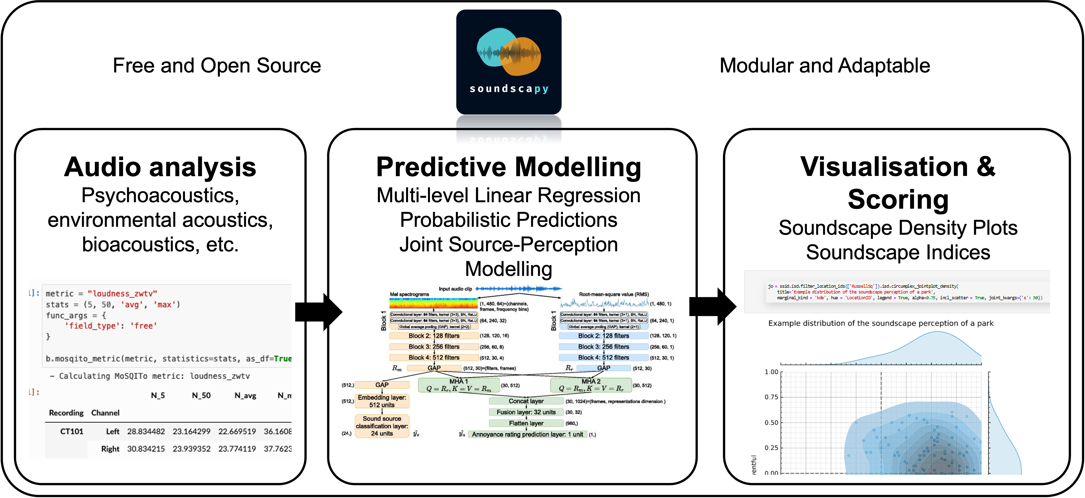
Future Work: Predictive Models⁶
Pretrained Models Integration:
Predict soundscape perception from acoustic features
Multiple model support for comparison
Design Optimization:
Predict impact of soundscape interventions
Assist in urban planning decisions
Modular Framework
Notes:
Explain the potential of integrating pretrained models for soundscape prediction. Discuss the implications for automated assessment and design optimization. Highlight how this could change the landscape of soundscape research and urban planning.

Slide 13
Future Work: Soundscape Perception Indices (SPI)⁷
Single Index Calculation:
Simplify complex soundscape data
Enable quick comparisons between locations
Standardized Reporting:
Facilitate communication with stakeholders
Support policy-making processes
Customizable Weighting:
Adapt to different cultural contexts
Account for varying research priorities
Applications:
Urban planning and design optimization
Environmental quality assessment
Cross-cultural soundscape studies

Slide 14
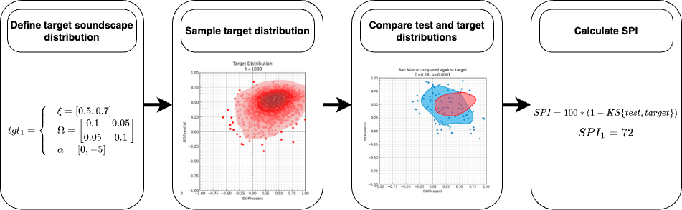
SPI Calculation Framework
Notes:
Introduce the concept of Soundscape Perception Indices (SPI). Explain how it simplifies complex data for easier interpretation and comparison. Discuss the potential applications in urban planning, policy-making, and cross-cultural studies.

Slide 15
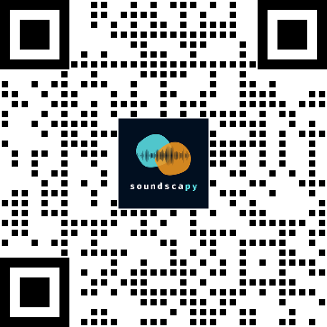
Conclusion
Standardized Analysis: Consistent with ISO 12913-3 guidelines
User-Friendly: Easy-to-use Python package for researchers and practitioners
Powerful Tools:
Distribution-based visualization
Comprehensive psychoacoustic analysis
Efficient batch processing
Future-Ready:
Ongoing development for predictive models
SPI for simplified soundscape assessment
Get Involved:
GitHub: github.com/MitchellAcoustics/Soundscapy
Docs: soundscapy.readthedocs.io
PyPI: pip install soundscapy
Notes:
Summarize the key benefits and features of Soundscapy. Emphasize its alignment with ISO standards and its user-friendly nature. Highlight the ongoing development and future directions. Encourage audience engagement and contributions. Provide clear information on how to access and start using Soundscapy.

Slide 16

References
Aletta, Francesco, Andrew Mitchell, Tin Oberman, Jian Kang, Sara Khelil, Tallal Abdel Karim Bouzir, Djihed Berkouk, et al. 2024. “Soundscape Descriptors in Eighteen Languages: Translation and Validation Through Listening Experiments.” Applied Acoustics 224 (September): 110109. https://doi.org/10.1016/j.apacoust.2024.110109.
Aletta, Francesco, and Simone Torresin. 2023. “Adoption of ISO/TS 12913-2:2018 Protocols for Data Collection from Individuals in Soundscape Studies: An Overview of the Literature.” Current Pollution Reports, October. https://doi.org/10.1007/s40726-023-00283-6.
Axelsson, Östen, Mats E. Nilsson, and Birgitta Berglund. 2010. “A principal components model of soundscape perception.” The Journal of the Acoustical Society of America 128 (5): 2836–46. https://doi.org/10.1121/1.3493436.
Hou, Yuanbo, Qiaoqiao Ren, Andrew Mitchell, Wenwu Wang, Jian Kang, Tony Belpaeme, and Dick Botteldooren. 2024. “Soundscape Captioning Using Sound Affective Quality Network and Large Language Model.” https://doi.org/10.48550/ARXIV.2406.05914.
Mitchell, Andrew, Francesco Aletta, and Jian Kang. 2022. “How to Analyse and Represent Quantitative Soundscape Data.” JASA Express Letters 2 (3): 037201. https://doi.org/10.1121/10.0009794.
Mitchell, Andrew, Francesco Aletta, Tin Oberman, and Jian Kang. 2024. “Soundscape Perception Indices (SPI): Developing Context-Dependent Single Value Scores of Multidimensional Soundscape Perceptual Quality,” July. https://doi.org/10.31234/osf.io/zpa9e.
Mitchell, Andrew, Tin Oberman, Francesco Aletta, Mercede Erfanian, Magdalena Kachlicka, Matteo Lionello, and Jian Kang. 2021. “The International Soundscape Database: An integrated multimedia database of urban soundscape surveys – questionnaires with acoustical and contextual information.” Zenodo. https://doi.org/10.5281/zenodo.5578572.
Oberman, Tin, Andrew Mitchell, Francesco Aletta, José Antonio Almagro Pastor, Kristian Jambrošić, and Jian Kang. 2024. “Soundscape Attributes Translation Project (SATP) Dataset.” Zenodo. https://doi.org/10.5281/ZENODO.10993139.
Ooi, Kenneth, Zhen-Ting Ong, Karn N. Watcharasupat, Bhan Lam, Joo Young Hong, and Woon-Seng Gan. 2023. “ARAUS: A Large-Scale Dataset and Baseline Models of Affective Responses to Augmented Urban Soundscapes.” IEEE Transactions on Affective Computing, 1–17. https://doi.org/10.1109/taffc.2023.3247914.
Also check out my other package for even more advanced circumplex analysis, currently under development!
This presentation is available online at https://mitchellacoustics.quarto.pub/internoise-2024-soundscapy-pres

Slide 17
Notes
1. Aletta and Torresin (2023)
2. Aletta et al. (2024)
3. Mitchell et al. (2021)
4. Oberman et al. (2024)
5. Ooi et al. (2023)
6. Hou et al. (2024)
7. Mitchell et al. (2024)

